Slide 1
#11 Victoria Regional Transit Commission Operations Update
September 18, 2018

Slide 2
Summer 2018 Service Observations
Summer 2018
Additional service added this summer over last summer
Noticeable increase in ridership, mainly from tourists
Routes to the ferries and Butchart Gardens impacted, local Sidney residents getting passed up more often due to increasing ferry foot passenger / luggage loads
Luggage impacts are growing and placing more pressure on accessible space
Service Related Construction impacts
McKenzie Overpass work – 60KMH work zone limits in effect; temporary highway lane relocation continues to impact schedules
Douglas St. bus lane improvement construction causing delays, considerable transit improvements highly anticipated on completion this fall
Special Events Update
Canada Day July 1 – 40 additional buses used and the day went smoothly
BC Day long weekend – 6 additional buses used for Symphony Splash
Labour Day weekend – 9 additional buses used for Saanich Fair

Slide 3
Summer 2018 Conventional Service Schedule Observations
High demand and seasonal service impact statistics
June – August 2018
330 schedule adherence complaints
Average 110/month vs 64/month for the same period last year
Primarily related to routes impacted by summer construction activities
212 customer pass up complaints
Average 71/month vs 30/month for the same period last year
Ridership has continued to grow during the summer months
Notable increase in complaints about passenger luggage vs. passenger ride space
19 scheduled connections missed
Average 6/month vs 5/month for the same period last year
Highest volume of customer service comments reflect service conditions between 7 a.m. and 8 a.m. (weekday commute times – unchanged from previous report)

Slide 4
Summer 2018 HandyDART Observations
High demand and seasonal service impact statistics
June – July 2018
Average monthly trips 26,971 vs 26,628 from same period last year, up 343 rides
Average monthly rides per service hour 2.47 vs 2.46 from the same period last year
Same Day / Next Day Last Minute Trip Request Statistics
June 2018 – 808 trips met, 352 trips not met, (70% met) vs 68% June 2017
July 2018 – 803 trips met, 290 trips not met, (73% met) vs 68% July 2017
June – July 2018 average 71.5% met vs 68% for same period last year

Slide 5
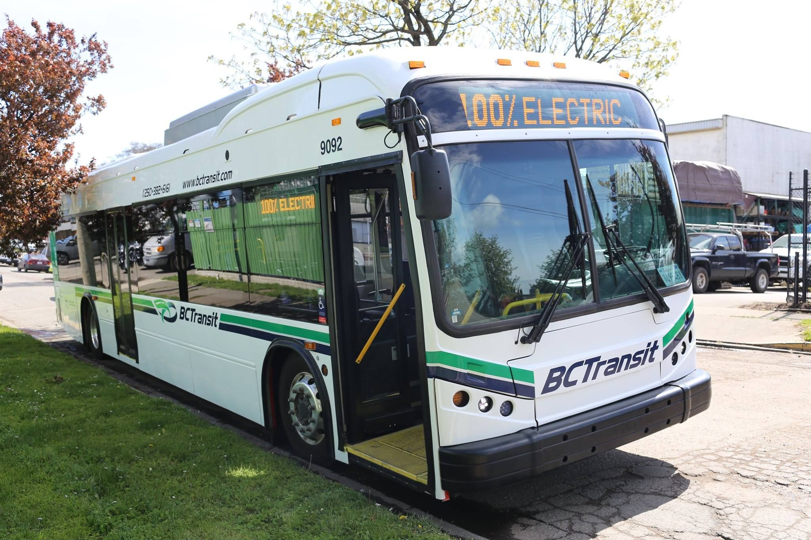
Update on Key Initiatives
Electric Bus Trial
First round of revenue service July 23 – August 17
2,454 km driven and 2,441 kWh of electricity used to charge
Energy consumption of 0.99 kWh/km
Electricity consumption charge approximately one quarter the equivalent cost of diesel fuel*
Second round of service occurring September 3 – 28
Pilot project concludes on October 5
Positive feedback from bus riders and local residents
Many comments around how quiet the bus is
*Not including maintenance, infrastructure costs, or higher electrical demand charges

