Slide 1
handyDART Customer Satisfaction Survey 2021

Slide 2
BACKGROUND AND METHODOLOGY Page 3
KEY FINDINGS Page 7
DETAILED RESULTS Page 11
Current usage of handyDART service and fixed-route bus service
Awareness and perceptions of supplemental taxi programs
Satisfaction with handyDART service
Key opportunities for service expansion
DEMOGRAPHICS Page 39
APPENDIX Page 41

Slide 3
Background and methodology

Slide 4
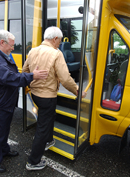
Background and Methodology
Background
Background
HandyDART is a door-to-door, shared ride service for passengers with physical or cognitive disabilities who are unable to use conventional public transit without assistance.
BC Transit commissioned Leger to conduct a study of users to measure handyDART usage as well as gauge satisfaction with the service.
The main objectives of the study are:
Understand the current usage of handyDART and regular bus services
Understand awareness and perceptions of supplemental taxi programs
Gauge satisfaction with handyDART service
Identify key opportunities for service expansion
Understand how COVID-19 affected usage of handyDART
Identify demographic factors tied to satisfaction levels

Slide 5
Background and Methodology
Methodology
Mixed data collection methodology – paper-based questionnaires with the option to complete online using computer-assisted web interviewing (CAWI) technology. Additionally, one survey was completed by phone.
Fieldwork was conducted from March 1st to March 16th, 2021.
In total, 581 handyDART customers completed the survey (535 via paper survey, 45 via online link and one by phone). Most customers confirmed that they had recently used the handyDART service.
A probability sample of 581 respondents has a margin of error of ±4.1%, 19 times out of 20.

Slide 6
Background and Methodology
PARTICIPANT Selection and contact
BC Transit provided the sample files for this study, including names and contact information of people believed to be recent handyDART users in each market served by BC Transit. Leger refined, cleaned, and standardized the sample files, removing any cases missing any contact information that could not be imputed. Once the contact database was compiled, Leger selected a random sample of 4,000 records to participate in the study. In all, 4,000 surveys were sent out by mail to potential respondents.
Despite updating and/or removing any obviously unusable contact information, some records were identified as belonging to people who had not been active handyDART users in the past year.
Of the 4,000 surveys sent out, 61 were processed by Leger as return-to-sender mail. About 14 phoned Leger to advise that the addressee was deceased, had moved into a care facility, or was otherwise no longer a handyDART user.

Slide 7
Key findings

Slide 8
Key Findings
The usage of handyDART service is lower in 2021 likely due to COVID-19
Only 17% use handyDART 5+ days or 2-3 days per week, a significant drop of 13% from 2020.
35% of riders use handyDART less than once a month, which is a 10-point increase compared to 2020.
Moreover, one-third (32%) of riders use handyDART less often compared to last year.
Medical appointments remain the main trip purpose for two-thirds of handyDART riders. However, probably due to the pandemic, riders are using it more for medical-related activities like medical appointments (68%) as well as running errands (37%), but less for social activities (23%) and adult day programs (15%).
Satisfaction with taxi programs decreased among handyDART riders
Two-thirds (68%) are aware of Taxi Saver which is slightly lower compared to 2020 (72%); awareness is particularly high in urban areas (76%).
The usage of the Taxi Saver program stay the same as last year’s results (60%).
Medical appointments (69%) and running errands (48%) are the main reasons for using taxi programs with 40% using it less than once a month and 32% several times per month.
Three-quarters (76%) of riders are satisfied with the service they received from the taxi company that was dispatched by handyDART. This is an 8-point decrease from 2020 (84%).

Slide 9
Key Findings
Riders are generally comfortable using handyDART and regular transit during the pandemic
Despite the pandemic, seven in ten (72%) riders are comfortable using handyDART and regular fixed-route bus service and three-quarters (76%) are satisfied with the measures that BC Transit has put in place to ensure that bus transportation is safe to ride during the pandemic.
HandyDART users tend to be satisfied with the service provided
Eight in ten (81%) rate themselves as satisfied.
Interestingly, heavy and medium-frequency riders (90% each) are more likely to be satisfied with handyDART service than occasional riders (72%).
Service elements involving handyDART staff tend to be very positively rated; both drivers and phone agents are perceived as helpful and courteous.
Service elements involving processes, on the other hand, tend to receive the lowest ratings. In particular, elements such as pick-up window wait-time, hours of operation, registration and phone “on-hold” wait times are the service areas with the most opportunity for improvement.
Three in ten (29%) agree the usage of handyDART service remains the same compared to a year ago.
handyDART service is more available in 2021
Nearly six in ten (59%) riders typically book a one-time trip rather than a regularly-scheduled trip (subscription).
handyDART service appears to be more available as only one-quarter of riders were unable to secure a trip when making a booking, a significant drop of 23% from 2020.

Slide 10
Recommendations for service improvements
If BC Transit has the available resources to invest in improvements to handyDART service, the following areas would be the top priorities among riders:
Extend service on weekends (specifically Sundays) and public holidays.
Later (after 8pm) and earlier service (before 9am) on weekdays.
Improve availability during existing hours by providing more buses and drivers. Long wait times tend to be a particularly common service element for improvement mentioned by riders.
Improve and simplify the scheduling process by reducing the minimum booking time, launching an online booking system, and providing calls/messages before the bus arrival.

Slide 11
Current usage of handyDART service and fixed-route bus service

Slide 12
Likely due to COVID-19 concerns, riders use the handyDART service less often now compared to last year
Over one-third are occasional riders (use handyDART once a month or less) which is a 10-point increase from 2020. Abbotsford residents are significantly more likely to be occasional riders (56%) than those in other communities.
 | 2021 | 2020
Heavy Rider 5+ days/2-3 days per week | 17% | 30%
Medium Rider Several times per month | 41% | 41%
Occasional Rider Once a month/ Less than once a month | 35% | 26%
Q1. In the past six months, how often have you used the handyDART service in your area?
Base 2021: Total, n=581. Base 2020: n=453.

Slide 13
One-time trip bookers and those who are uncomfortable riding transit during the pandemic tend to use handyDART once a month or less
Subscription trip riders are more likely to be heavy riders (35%) than one-time bookers (8%), while urban residents are more likely to be medium riders (45%) compared to rural regions.
 | Total (n=581) | Trip booking type |  |  | Region |  | Comfort level using transit
 |  | Subscription trip (n=84) | One-time trip (n=340) | Both (n=105) | Urban (n=373) | Rural/ Smaller Urban (n=208) | Uncomfortable (n=58) | Comfortable (n=416)
Heavy Rider 5+ days/2-3 days per week | 17% | 35% | 8% | 38% | 17% | 17% | 7% | 22%
Medium Rider Several times per month | 41% | 39% | 49% | 30% | 45% | 35% | 7% | 50%
Occasional Rider Once a month/ Less than once a month | 35% | 24% | 38% | 29% | 33% | 39% | 74% | 25%
Q1. In the past six months, how often have you used the handyDART service in your area?
Significantly higher at the 95% level.
Base 2021: Total, n=581.

Slide 14
Medical appointments remain the main trip purpose for two-thirds of handyDART riders
Overall, handyDART trip purposes are similar to 2020. However, likely due to the pandemic, riders are using the service more for medical related activities, and less so for social activities and adult day programs.
* Other, None of the above, PNTA answer options are not displayed
Q2. Which of the following trip purposes do you use handyDART service for? (Multiple mentions)
Base 2021: Total, n=581. Base 2020: Total, n=453.

Slide 15
Medium-frequency riders are more likely to use handyDART for medical appointments than other rider groups
 | Total (n=581) | handyDART ridership frequency |  |  | Trip booking type
 |  | Heavy Rider (n=101) | Medium Rider (n=241) | Occasional Rider (n=206) | Subscription trip (n=84) | One-time trip (n=340) | Both (n=105)
Medical appointments | 68% | 53% | 81% | 64% | 67% | 81% | 40%
Running errands | 37% | 36% | 49% | 24% | 42% | 41% | 24%
Social outings | 23% | 24% | 23% | 22% | 36% | 20% | 31%
Medical treatments | 22% | 29% | 26% | 15% | 29% | 24% | 15%
Adult day-program | 15% | 35% | 7% | 15% | 27% | 5% | 40%
Going to work or school | 4% | 7% | 3% | 5% | 5% | 2% | 10%
Q2. Which of the following trip purposes do you use handyDART service for?
Significantly higher at the 95% level.
Base 2021: Total, n=581.

Slide 16
Six in ten riders never use the regular fixed-route bus service which is consistent with last year results
Abbotsford residents are more likely to say they do not use the regular fixed-route bus service (77%).
Q3. In the past six months, how often have you used the regular fixed-route bus service in your area?
Base 2021: Total, n=581. Base 2020: Total, n=453.

Slide 17
handyDART use is much higher than regular fixed-route bus service use
Q1. In the past six months, how often have you used the handyDART service in your area?
Q3. In the past six months, how often have you used the regular fixed-route bus service in your area?
Base 2021: Total, n=581.

Slide 18
Running errands is the main trip purpose for the regular bus service users, while handyDART is more typically used for medical appointments
Q2. Which of the following trip purposes do you use handyDART service for? (Multiple mentions)
Q4. Which of the following trip purposes do you use the regular fixed-route bus service for? (Multiple mentions)
Base 2021: Total, n=581.

Slide 19
One-third of riders take handyDART less frequently in 2021 compared to last year
Q5. Compared to a year ago, has your use of the handyDART service changed?
Base 2021: Total, n=581. Base 2020: Total, n=453.

Slide 20
Awareness and perceptions of supplemental taxi programs

Slide 21
Over two-thirds of riders are aware of the Taxi Saver program
Urban riders (76%) are more likely to be aware of the Taxi Saver program than those in rural areas (54%).
All Penticton riders surveyed (100%) are aware of the Taxi Saver program, which is the highest awareness rate among all the regions.
Awareness of the Taxi Saver program in 2021
 | Region |  | City
 | Urban (n=373) | Rural/ Small Urban (n=208) | Victoria (n=159) | Kelowna (n=86) | Abbotsford (n=39) | Vernon (n=35) | Penticton (n=25)
Yes | 76% | 54% | 84% | 86% | 82% | 26% | 100%
No | 19% | 35% | 12% | 10% | 13% | 66% | -
Q9. Are you aware of the Taxi Saver program?
Significantly higher at the 95% level.
Base 2021: Total, n=581. Base 2020: Total, n=453.

Slide 22
Six in ten riders who are aware of the Taxi Saver program also use the Taxi Saver program which is consistent with last year results
Riders from urban areas (66%) are more likely to say they use the Taxi Saver program than those from rural or smaller urban areas (45%).
Usage of the Taxi Saver program in 2021
 | Trip booking type |  |  | Region
 | Subscription trip (n=55) | One-time trip (n=238) | Both (n=75) | Urban (n=283) | Rural/ Small Urban (n=113)
Yes | 49% | 68% | 45% | 66% | 45%
No | 49% | 31% | 51% | 33% | 50%
Significantly higher at the 95% level.
Q10. Do you use the Taxi Saver program?
Base 2021: Those who are aware of the Taxi Saver program in Q9, n=396. Base 2020: Those who are aware of the Taxi Saver program in Q9, n=325.

Slide 23
Four in ten Taxi Saver riders use the service less than once a month, while one-third who use the Taxi Saver program several times per month
Medical appointments (69%), running errands (48%) and social outings (27%) are the main trip purposes for Taxi Saver program users.
* Mentions less than 3% are not displayed
Q10A. How often do you use the Taxi Saver program? Q10B. Which of the following reasons do you use the Taxi Saver program for? (Multiple mentions).
Base 2021: Those who use the Taxi Saver program in Q10, n=238.

Slide 24
Satisfaction with the taxi company that was dispatched by handyDART is lower this year
Nearly half (47%) of riders had a taxi dispatched by handyDART.
Two-thirds (76%) of Taxi Saver users are satisfied with the Taxi program which is a directional decrease of 8 points compared to 2020 (84%).
Total Satisfied
(Very Satisfied / Satisfied)
76%
84%
Q11. Have you ever had a taxi dispatched by handyDART when you called to schedule a ride, instead of a bus?
Q12. How satisfied are you with the service you received from the taxi company that was dispatched by handyDART?
Base 2021: Total, n = 581. Those who had a taxi dispatched in Q11, n=274. Base 2020: Total, n=453. Those who had a taxi dispatched in Q11, n=239.

Slide 25
Satisfaction with handyDART service

Slide 26
Eight in ten riders are satisfied with handyDART service in 2021
Heavy and medium-frequency riders (90% each) are more likely to say they are satisfied with the handyDART service than occasional riders (72%).
Total Satisfied (Very Satisfied/ Satisfied)
81%
77%
* Mentions less than 2% are not displayed
Q6. Overall, how satisfied are you with the handyDART service in your area?
Base 2021: Total, n=581. Base 2020: Total, n=453.

Slide 27
Phone “on hold,” registration wait time, hours of operation, and pick-up window wait time are the handyDART service areas with the most opportunity for improvement
86%
85%
85%
84%
82%
DRIVER COURTESY, HELPFULNESS
VEHICLE SAFETY
VEHICLE COMFORT AND CLEANLINESS
VALUE FOR FARE PAID
PHONE AGENT COURTESY, HELPFULNESS
72%
71%
69%
66%
65%
REGISTRATION PROCESS
APPOINTMENT SCHEDULING PROCESS
PHONE “ON HOLD” WAIT TIME
REGISTRATION WAIT TIME
HOURS OF OPERATION
61%
PICK-UP WINDOW WAIT TIME
Q7. How satisfied are you with each of the following elements of handyDART service?
The charts show Total Satisfaction (Very Satisfied/Satisfied).
Base 2021: Total, n=581.

Slide 28
Over half of riders feel that handyDART service has stayed consistent compared to a year ago
Heavy (30%) and medium riders (38%) are more likely to say that the handyDART service is better in 2021 compared to a year ago.
Total Better
(Much better/
Somewhat better)
Total Worse
(Much worse/
Somewhat worse)
26%
3%
19%
6%
Q8. Compared to a year ago, is the handyDART service better, the same, or worse?
Base 2021: Those who used the handyDART service a year ago, n=478. Base 2020: Those who used the handyDART service a year ago, n=387.

Slide 29
Seven in ten riders are comfortable using transit service during the pandemic
Heavy (90%) and medium frequency (87%) riders, as well as subscription trip users (88%) are more comfortable taking transit during the pandemic.
Total Comfortable (Very/ Somewhat Comfortable)
72%
Q8A. With the current situation in mind, how comfortable do you feel using handyDART and/or regular fixed-route bus service during the pandemic?
Base 2021: Total, n=581.

Slide 30
Three-quarters of riders are satisfied with the measures that BC Transit has put in place during the pandemic to ensure buses are safe to ride
Heavy (94%) and medium frequency (92%) riders, as well as subscription trip users (88%), are more likely to be satisfied with BC Transit’s safety measures during the pandemic.
Total Satisfied (Very/ Somewhat Satisfied)
76%
Q8B. How satisfied are you with the measures that BC Transit has put in place during the pandemic to ensure that bus transportation is safe to ride (i.e. driver procedures, mandatory masks, disinfection, etc.)?
Base 2021: Total, n=581.

Slide 31
Key opportunities for service expansion

Slide 32
More than one-half of riders typically book a one-time trip as opposed to a subscription trip
Riders from urban regions are more likely to book a one-time trip (63%).
handyDART booking type in 2021
 | handyDART ridership frequency |  |  | Region
 | Heavy Rider (n=101) | Medium Rider (n=241) | Occasional Rider (n=206) | Urban (n=373) | Rural (n=208)
One-time trip | 28% | 70% | 63% | 63% | 50%
Subscription trip | 29% | 14% | 10% | 14% | 15%
Both | 40% | 13% | 15% | 17% | 19%
Q13. Which of these statements most accurately describes how you use handyDART?
Significantly higher at the 95% level.
Base 2021: Total, n=581. Base 2020: Total, n=453.

Slide 33
handyDART service appears to be more available in 2021 as only one-quarter of riders have been unable to secure a trip when they called to make a booking (a significant drop of 23% from last year)
Of those unable to secure a trip in 2021, 55% still made the trip using another mode.
Q14: In the past year, have you been unable to secure a trip using handyDART when you called to make a booking? Base 2021: Those who booked a one-time trip or a combination of subscription/one-time trips, n=445. Base 2020: Those who booked a one-time trip or a combination of subscription/one-time trip, n=301.
Q15: Thinking of the last trip that handyDART was not able to fulfil, did you take that trip using another mode of transportation? Base 2021: Those, who were unable to secure a trip in Q14, n=109. Base 2020: Those, who were unable to secure a trip in Q14, n=142.

Slide 34
Three in ten riders would like to see handyDART service on Sundays, the top suggestion for service expansion
“More flexibility in hours e.g. later service, evening service, etc. we have lives too (or would if we could get there).”
 | Total (n=578)
Introduce service on Sundays | 29%
Introduce service on holidays | 19%
Later service on weekdays (after 8pm) | 17%
Earlier service on weekdays (before 9am) | 16%
Later service on Saturdays (after 6pm) | 15%
Improve availability during existing hours | 13%
Extend service to new areas | 8%
Earlier service on Saturdays (before 9am) | 6%
None of the above | 24%
Prefer not to answer | 13%
“Sometimes they're not available to pick up during scheduled hours. Maybe they can add more pick up/drop off times.”
“I live in the Interior of BC and would like to have service available to other communities on a regular basis.”
“I feel it would be great if available on weekends and holidays to get patrons to events or other places that would not be available with out this service.”
“Maybe an additional vehicle & drivers - I have often been sent a taxi rather than the handyDART bus.”
*Only those answers mentioned by 5% or more are shown here
Q16. If resources were available to expand handyDART service, what change(s) would you most like handyDART to implement?
Q17. Specifically, what areas would you like handyDART service to cover that it does not today?
Base 2021: Total, n=578.

Slide 35
Two in ten riders who say they want to see improved availability during existing hours would like to have shorter window for their booking period and more buses
 | Total (n=73)
Shorter window for booking period | 19%
More buses/Increased frequency | 18%
Shorter wait times | 10%
Expand service to new areas | 7%
Expand service on weekends | 5%
Extend (earlier) service | 4%
Extend (later) service | 3%
“It would be nice if you didn't have to book a ride two days ahead to book for an appointment.”
“More buses so I could call at the last minute for a ride if something came up.”
“More handyDARTs on the road for picking people up earlier than their scheduled pick-up. For example, if a client finishes an appointment earlier than anticipated, perhaps have more roaming buses near the hospitals (for example) to accommodate people so they don't have to wait so long.”
“More buses and drivers.”
“Not have to be on standby almost every trip, even when I book two weeks ahead.”
*Only those answers mentioned by 3% or more are shown here
Q18. Specifically, how would you like handyDART service to be more available than it is today?
Base 2021: Those who selected “improve availability during existing hours” in Q16, n=73.

Slide 36
Suggestions for improvements to handyDART
Positive comments (pleasant, helpful) – 22%
“A handyDART service picking up as well as going out. Grateful to have our outing, and re-enjoy our lives again, having something to look forward to. Many thanks if that is possible. Always grateful for at least things to light our spirits.”
“I am perfectly happy with the handyDART service I receive.”
“I have found the drivers very good and look after the passengers very well. They show a lot of patience with the disabled and help those with problems.”
“A full wonderful service. Drivers are helpful. Thank you for your dedication and service.”
Reduce the minimum booking time – 7%
“I would like to see a much shorter booking time. Four or five days would be nice two weeks is just way too long.”
“If it’s possible shorten the one-week lead time for bookings e.g., doctors' appointments. This is a beneficial service to me I only use it from October to April but maybe needing it year-round.”
“One cannot book handyDART to just go shopping as one has to book well in advance. Also find with medical appts one never knows how long it will take person so it’s not convenient to book a return as a person can wait an hour or more.”
Q19. Do you have any additional comments or suggestions for improvements to handyDART service?
Base 2021: Total, n=581.

Slide 37
Suggestions for improvements to handyDART
Improve customer service – 4%
“”How do you get to a doctor appt when you do not know if you can arrive on time? If we book in advance, we should be assured of our time barring any weather holdups. Better not to use the handyDART sadly.”
“Better "Taxi Service" for people with walkers.”
“I registered for handyDART when I had knee replacement surgery, but I had not been informed that I was eligible to use it. So, I think there should be more follow up after registration to inform potential users that they have access to this service.”
Unwilling to utilize handyDART during COVID-19 – 4%
“In the past 4-5 months John has not been using handyDART due to the increase in COVID-19 cases in Island Health. Hopefully, he can resume in the near future after being vaccinated.”
“We enjoyed the using handyDART before the Covid-19 pandemic. However, Covid has changed a lot of the old patterns in our lives. When the pandemic is over, we would like the resume using the handyDART.”
“I have only used when my daughter was not available to take me. Very much appreciated during emergencies. With COVID try not to go out at all. I was very satisfied with handyDART.”
Q19. Do you have any additional comments or suggestions for improvements to handyDART service?
Base 2021: Total, n=581.

Slide 38
Suggestions for improvements to handyDART
Reduced wait times for service – 3%
“I would change to shorter wait times before trips.”
“I would like to be notified if they will be late picking up my mom from the hospital, so she isn't waiting outside in the cold or rain after her dialysis run. Some are good about it, but others aren’t.”
More communication – 3%
“We would like to receive a confirmation email of appointments because sometimes the booking agent has not recorded the information or change to schedule in the computer. Ideally, an online booking system would be much better, with a phone-in system still available for those who can't book online.”
“I would have liked more information at first regarding rules about booking. It was difficult & embarrassing at times when I had to find out by making an error.”
Increase service hours – 3%
“Longer service hours and Sunday service would be very helpful.”
“Have service on Sundays. Have extended hours. Very good service. No problems ever.”
Q19. Do you have any additional comments or suggestions for improvements to handyDART service?
Base 2021: Total, n=581.

Slide 39
Demographics

Slide 40
Demographics
Region
Passenger/a caregiver
Participant source
URBAN
64%
PASSENGER
70%
PAPER-BASED
92%
OTHER
7%
RURAL
36%
CAREGIVER
19%
ONLINE
8%
City
Q20. Who completed this survey?
Base 2021: Total, n=581.

Slide 41
Appendix

Slide 42
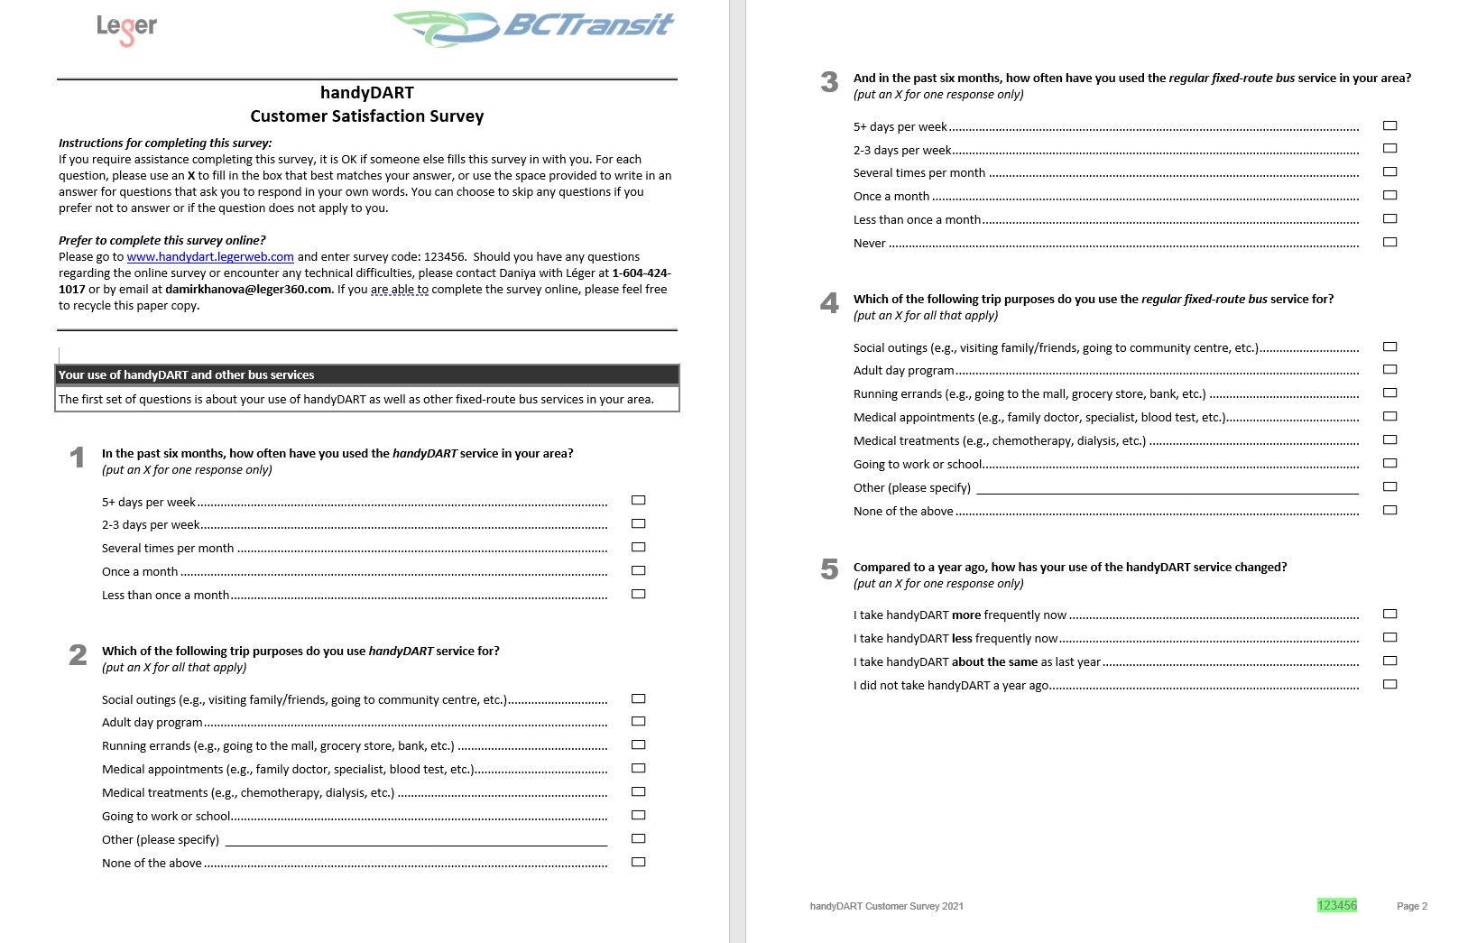
Questionnaire

Slide 43
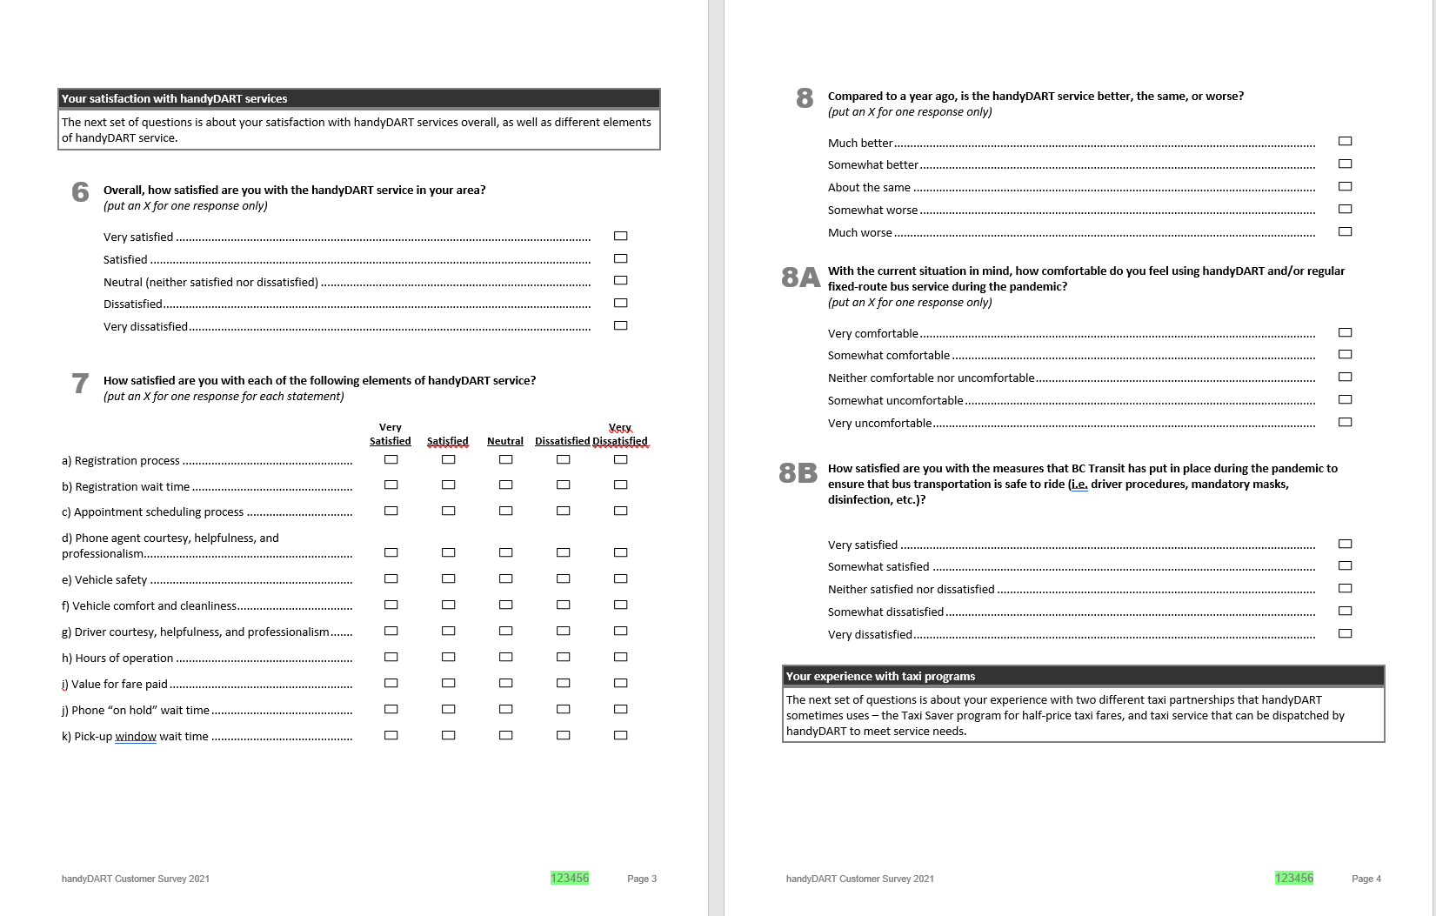
Questionnaire

Slide 44
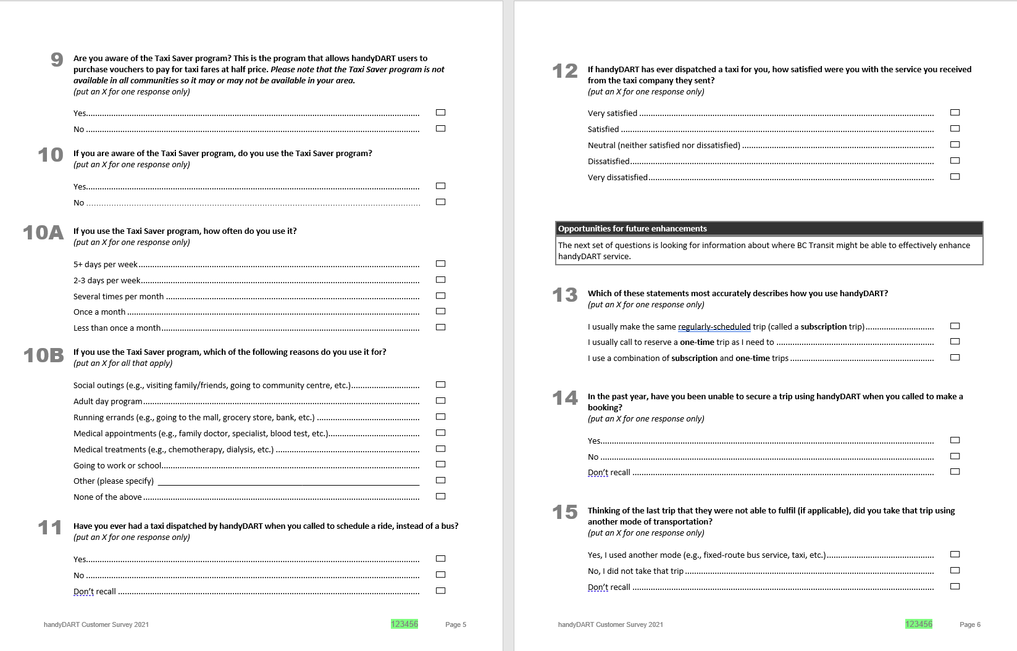
Questionnaire

Slide 45
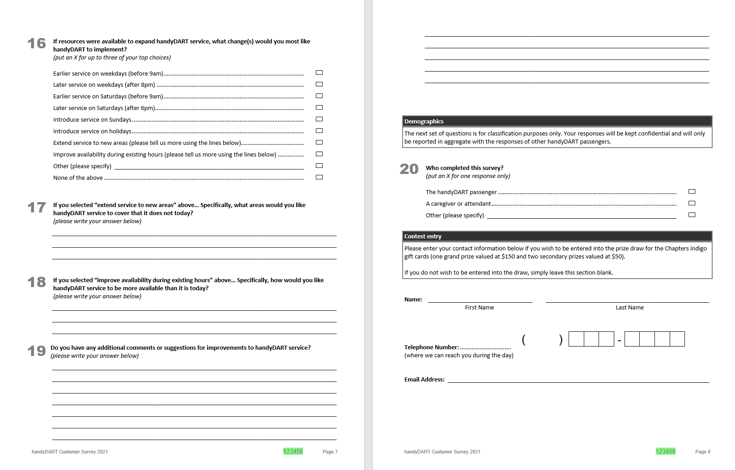
Questionnaire

