Slide 1
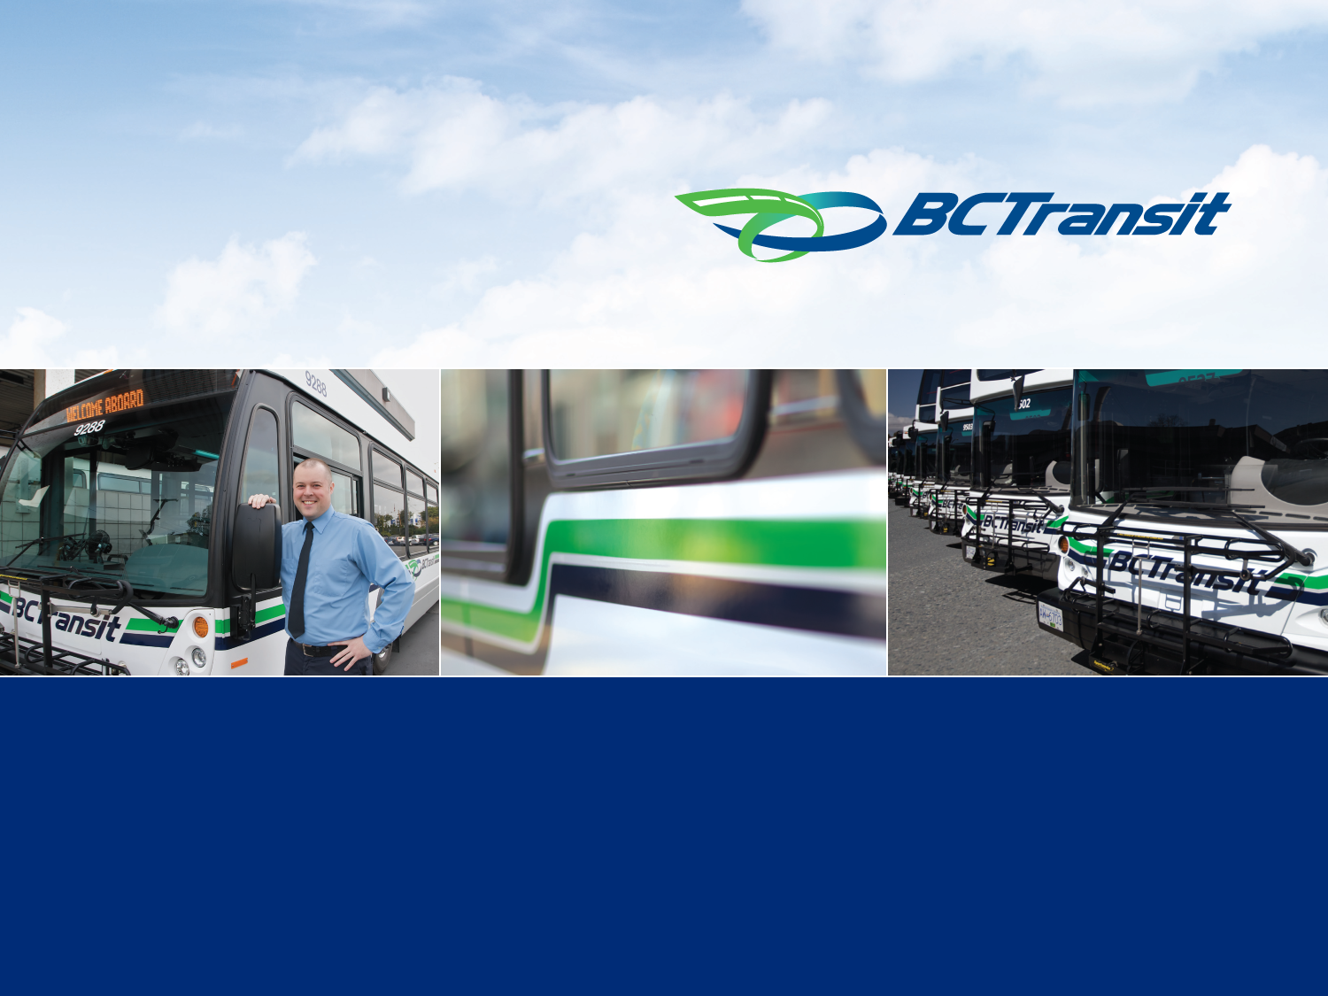
#7 - Victoria Regional Transit
Financial and Performance Report
Year to Date July 31, 2018

Slide 2
Financial Presentation
This Financial Summary is presented on the following basis:
Order in Council 594, approved October 2015, enables BC Transit to establish reserves to carry forward operating savings each year to offset future inflationary increases for base service levels.
Effective April 1, 2015, both the Province and Local Government funding partners will be invoiced the budgeted amount, the full value of any savings in operating expenses will be held in an operating reserve to be applied against future year costs. This mechanism does not apply to facility and vehicle infrastructure charges (Lease Fees).

Slide 3
Financial Summary

Slide 4
Revenue and Passenger Trips
Passenger revenue is $0.05M (0.4 per cent) higher than budget year to date and is forecast to be on budget at year end.
    Advertising revenue is 1.4 per cent above budget year to date and is forecast to be 1.5 per cent above budget at year end.
    Passenger trips are 19,000 (0.2 per cent) higher than budget year to date and are forecast to be on budget at year end.

Slide 5
Provincial Operating Contribution, Fuel Tax and Local Contribution
  Provincial Operating Contribution is on budget year to date and forecast to be on budget at year end.
  Fuel Tax Revenue generated from a 5.5 cent per litre fuel tax is $0.15M (2.4 per cent) above budget year to date based on higher than budgeted volume of fuel sales in the Victoria Region. The forecast reflects the year to date variance.
  Local Contribution is $0.48M (4.7 per cent) below budget year to date due to higher passenger and fuel tax revenues and lower lease fees. The year end forecast is $0.16M (0.6 per cent) below budget. Local contribution reflects the Commission’s share of budgeted operating expenses and actual lease fees net of passenger, advertising and fuel tax revenues.

Slide 6
Operations
  Operations (excl. Fuel) is $1.60M (6.9 per cent) below budget year to date and is forecast to be $0.33M (0.5 per cent) below budget at year end. Year to date variance reflects the timing of the Douglas Street bus lanes project, delays related to the transition to the digital CREST radio network, and lower labour costs. The forecast reflects lower labour and CREST radio network costs.
  Fuel is $0.39M (9.3 per cent) below budget year to date due to an average fuel price of $1.23/L compared to budgeted fuel price of $1.28/L. The fuel forecast recognizes year to date savings.
  Service hours delivered year to date are on budget and expected to remain on target by year end. Service hours include approved expansion of 10,000 annual hours effective September 2018 for new routes and improved service levels.

Slide 7
Maintenance
  Fleet Maintenance is $0.42M (5.8 per cent) lower than budget year to date due to timing of filling vacancies and timing of maintenance activities. The year end forecast is $0.90M (0.4 per cent) lower than budget at year end due to lower labour costs.
  Facilities Maintenance is $0.20M (16.0 per cent) below budget year to date primarily due to timing of filling vacancies offset by higher than budgeted facility lease expenses. The forecast for year end is $0.06M (1.6 per cent) higher than budget due to higher than expected facility lease expenses.

Slide 8
Administration
Administration is $0.03M (0.6 per cent) higher than budget year to date due to timing of expenditures. The year end forecast reflects higher than anticipated transition and information system costs, offset by timing of filling vacancies and lower than expected legal and consulting costs.

Slide 9
Lease Fees
  Lease Fees are $0.27M (4.3 per cent) below budget due to timing of asset acquisition/construction activities and are forecast to be on budget at year end.

Slide 10
Transit Fund

Slide 11
Operating Reserve Fund
Order in Council 594, approved October 2015, enables BC Transit to establish reserves to carry forward operating savings each year to offset cost inflationary costs increases for base service levels. This mechanism does not apply to facility and vehicle infrastructure charges (Lease Fees).
Operating reserve fund is independent of Transit Fund and is to be used for maintaining existing service levels.

Slide 12
Performance and Benchmarking
Victoria Regional Transit Commission

Slide 13
Conventional Transit Performance

Slide 14
Custom Transit Performance

