Slide 1
handyDART Customer Satisfaction Survey 2022

Slide 2
Background & Methodology 03
Key Findings 07
Detailed Results 11
Ridership elements 12
Satisfaction with handyDART service 23
Key opportunities for service expansion 29
Awareness and perceptions of supplemental 36 taxi programs
Respondent Profile 42
Appendix 44

Slide 3
BACKGROUND & METHODOLOGY

Slide 4
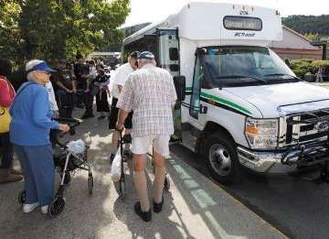
BACKGROUND AND METHODOLOGY
BACKGROUND
handyDART is a door-to-door, shared-ride service for passengers with physical or cognitive disabilities who are unable to use conventional public transit without assistance.
Since 2020, BC Transit has commissioned Leger to conduct an annual study of users to measure handyDART usage as well as gauge satisfaction with the service.
The main objectives of the study are:
Understand the current usage of handyDART and regular bus services
Understand awareness, perceptions and usage needs of supplemental taxi programs
Gauge satisfaction with handyDART service
Identify key opportunities for service expansion
Understand how COVID-19 affected usage of handyDART
Identify demographic factors tied to satisfaction levels
Identify preferred method of trips booking and management

Slide 5
BACKGROUND AND METHODOLOGY
METHODOLOGY
 | Mixed data collection methodology – paper-based questionnaires with the option to complete online using computer-assisted web interviewing (CAWI) technology.
 | Fieldwork was conducted from March 1st to March 20th, 2022.
 | In total, 1,203 handyDART customers completed the survey (1087 via paper survey, 92 via online link and 24 by phone). All respondents confirmed that they had recently used the handyDART service.
 | A probability sample of 1,203 respondents has a margin of error of ±2.8% 19 times out of 20.

Slide 6
BACKGROUND AND METHODOLOGY
PARTICIPANT Selection and contact
BC Transit provided the sample files for this study, including names and contact information of people believed to be recent handyDART users in each market served by BC Transit. Leger refined, cleaned, and standardized the sample files, removing any cases missing any contact information that could not be imputed. Once the contact database was compiled, Leger selected a random sample of 7,000 records to participate in the study. In all, 7,000 surveys were sent out by mail to potential respondents.
Despite updating and/or removing any obviously unusable contact information, some records were identified as belonging to people who had not been active handyDART users in the past year.
About 18 people phoned Leger to advise that the addressee was deceased, had moved into a care facility, or was otherwise no longer a handyDART user.

Slide 7
KEY FINDINGS

Slide 8
Key Findings (p. 1 of 2)
The use of handyDART recovered in 2022 to near pre-pandemic 2020 levels likely due to the majority of the population being vaccinated
One-quarter use handyDART 5+ days or 2 to 3 days per week, a significant increase from 2021.
28% of riders use handyDART less than once a month, which is a 7-point decrease compared to 2021.
Four in ten say they use handyDART about the same amount compared to a year ago while two in ten say they are using it more frequently.
Medical appointments remain the main trip purpose for two-thirds of handyDART riders, followed by running errands (30%).
handyDART service availability dropped in 2022
handyDART service was less available as four in ten riders were unable to secure a trip when making a booking, a significant increase from 2021.
Similar to previous years, more than one-half of riders typically book a one-time trip as opposed to a regularly-scheduled trip (subscription).
handyDART users continue to be satisfied overall with the service provided
Nearly eight in ten (77%) rate themselves as satisfied, directionally lower but not significantly so compared to 81% in 2021.
Interestingly, heavy and medium-frequency riders (~84% each) are each more likely to be satisfied with handyDART service than occasional riders (66%).
Service elements involving handyDART staff tend to be very positively rated; both drivers and phone agents are perceived as helpful and courteous. Vehicle comfort and cleanliness and comfort also remain among the top-rated service elements.
(continued on next page)

Slide 9
Key Findings (p. 2 of 2)
Service elements involving processes, on the other hand, still receive the lowest ratings -- elements such as pick-up window wait time, appointment scheduling process, registration and phone “on-hold” wait times continue to have the most opportunity for improvement.
Riders are generally comfortable using handyDART and regular transit during the pandemic
Despite the continuing pandemic, three-quarters (76%) of riders are comfortable using handyDART and regular fixed-route bus service and are also satisfied (82%) with the measures that BC Transit has put in place to ensure that bus transportation is safe to ride during the pandemic.
Three-quarters of riders are not interested in electronic payments or using a website/app to book handyDART trips
Most (81%) would still prefer to book their rides over the phone.
Awareness, use, and satisfaction with the taxi saver program is about the same as last year
Almost three-quarters of riders are aware of the Taxi Saver program; awareness is particularly high in urban areas (79%), and half of them has had taxi dispatched to them by handyDART.
The use of the Taxi Saver program remains the same as the previous years’ results (60%). Four in ten prefer to keep vouchers to be used on an as-needed basis and one-third like to use the service for shorter trips.
Medical appointments (67%) and running errands (42%) continue to be the main reasons for using taxi programs with half of the riders using it one or more times a month.
Satisfaction with taxi companies is at 79%, directionally but not significantly higher than 2021 (76%).

Slide 10
Recommendations for Service Improvements
If BC Transit has the available resources to invest in improvements to handyDART service, similar to last year, the following areas would be the top priorities among riders:
Introduce service on Sundays and public holidays – these are perennially the top choices for potential changes.
Improve availability during existing hours – similar to previous years, top suggestions include providing more buses/increased frequency, having a shorter window for their booking period (several commented that it should less than the current two weeks), reducing wait times, and more scheduling flexibility in terms of pickup times and being allowed some extra time at their destination if needed.
Provide later (after 8pm) and earlier service (before 9am) on weekdays as well as later service on Saturdays (after 6pm).

Slide 11
DETAILED RESULTS

Slide 12
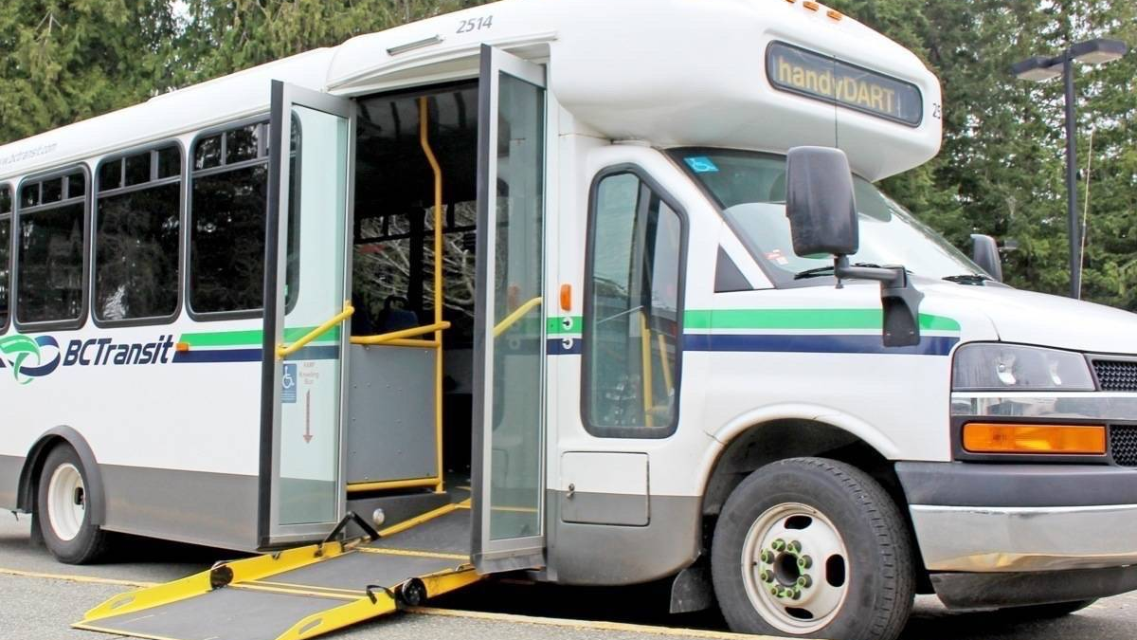
Ridership elements

Slide 13
With vaccinations occurring in the past year, handyDART ridership recovered to be close to pre-pandemic 2020 levels
One-quarter are heavy riders (use handyDART 2+ times a week) which is an 8-point increase from 2021.
Residents of Victoria, Kelowna and Abbotsford are significantly more likely to be heavy riders (29%) than those in other communities. Kamloops residents are more likely to only ride once a month (25%) compared with other cities.
 | 2022 | 2021 | 2020
HEAVY RIDER 5+ days/2-3 days per week | 25% | 17% | 30%
MEDIUM RIDER Several times per month/Once a month | 43% | 41% | 41%
OCCASIONAL RIDER Less than once a month | 28% | 35% | 26%
Base 2022: n=1,203. Base 2021: Total, n=581. Base 2020: n=453.
Q1. In the past six months, how often have you used the handyDART service in your area?

Slide 14
Those who regularly book both subscription and one-time trips are more likely to be heavy riders, with the proportion of this group up 22% from last year
One-time trip bookers are primarily medium or occasional riders (53% and 36%, respectively).
Interestingly, there is a considerable increase in handyDART usage among who say they are uncomfortable using transit, with the proportion of heavy riders doubling and medium riders quadrupling in 2022 compared to 2021.
 |  | TRIP BOOKING TYPE |  |  | REGION |  | COMFORT LEVEL USING TRANSIT
 | TOTAL (n=1,203) | Subscription Trip (n=145) | One-Time Trip (n=651) | Both (n=292) | Urban (n=789) | Rural/ Smaller Urban (n=414) | Uncomfortable (n=82) | Comfortable (n=920)
HEAVY RIDER 5+ days/2-3 days per week | 25% | 47% | 8% | 60% | 25% | 25% | 16% | 29%
MEDIUM RIDER Several times per month/ Once a month | 43% | 41% | 53% | 29% | 46% | 38% | 35% | 45%
OCCASIONAL RIDER Less than once a month | 29% | 12% | 36% | 8% | 27% | 31% | 46% | 24%
Base 2022: Total, n=1.203.
Q1. In the past six months, how often have you used the handyDART service in your area?
Significantly higher at the 95% level.

Slide 15
Four in ten handyDART users are using the service the same as last year while nearly two in ten are using it slightly more
Base 2022: n=1,203. Base 2021: Total, n=581. Base 2020: n=453.
Q5. Compared to a year ago, has your use of the handyDART service changed?

Slide 16
Medical appointments remain the main trip purpose for two-thirds of handyDART riders
Overall, handyDART trip purposes are similar to previous years, with a slight increase in usage for social outings and adult day programs. Kamloops riders (89%) are more likely to use the service for medical appointments while Victoria riders (32%) tend me to use it for social outings and adult day programs.
* Other, None of the above, PNTA answer options are not displayed
Base 2022: Total, n=1,203 Base 2021: Total, n=581. Base 2020: Total, n=453.
Q2. Which of the following trip purposes do you use handyDART service for? (Multiple mentions)

Slide 17
Medium-frequency and one-time trip bookers are more likely to use handyDART for medical appointments than other rider groups
Heavy riders increased their service usage for adult-day programs (+8%) and medium riders for social outings (+9%) compared to last year.
 |  | HANDYDART RIDERSHIP FREQUENCY |  |  | TRIP BOOKING TYPE
 | TOTAL (n=1,203) | Heavy Rider (n=120) | Medium Rider (n=202) | Occasional Rider (n=138) | Subscription Trip (n=145) | One-Time Trip n=651) | Both (n=292)
Medical appointments | 64% | 39% | 78% | 68% | 66% | 82% | 30%
Running errands | 30% | 24% | 42% | 20% | 38% | 37% | 15%
Social outings | 27% | 28% | 32% | 19% | 32% | 29% | 24%
Medical treatments | 20% | 22% | 22% | 16% | 27% | 21% | 19%
Adult day-program | 18% | 48% | 10% | 6% | 27% | 5% | 49%
Going to work or school | 5% | 11% | 3% | 2% | 16% | 2% | 7%
Base 2022: Total, n=1,203.
Q2. Which of the following trip purposes do you use handyDART service for?
Significantly higher at the 95% level.

Slide 18
Similar to previous years, more than one-half of riders typically book a one-time trip as opposed to a subscription trip
Heavy riders are more likely to use a combination of subscription and one-time booking, while medium (67%) and occasional riders (70%) are way more inclined to book one-time trips. Kamloops riders are also more likely to book one-time trips (79%) compared to other communities.
handyDART BOOKING TYPE in 2022
TYPICAL handyDART
Booking Type
 | HANDYDART RIDERSHIP FREQUENCY |  |  | REGION
2022 | Heavy Rider (n=299) | Medium Rider (n=518) | Occasional Rider (n=340) | Urban (n=789) | Rural/ Smaller Urban (n=414)
One-time trip | 17% | 67% | 70% | 56% | 50%
Subscription trip | 23% | 11% | 5% | 12% | 11%
Combination of Subscription and One-time trip | 59% | 17% | 7% | 24% | 25%
I usually call to reserve a one-time trip as I need to
I use a combination of subscription and one-time trips
I usually make the same regularly-scheduled trip (subscription trip)
Prefer not to answer
Base 2022: Total, n=1,203. Base 2021: Total, n=581. Base 2020: Total, n=453.
Q13. Which of these statements most accurately describes how you use handyDART?
Significantly higher at the 95% level.

Slide 19
handyDART service availability fell compared to 2021 as four in ten riders were unable to secure a trip when they called to make a booking, a significant drop from last year
Of those unable to secure a trip, 55% still made the trip using another type of transportation.
UNABLE to Secure a Trip
USAGE of Another Mode of Transportation
Yes
No
Don’t recall
Prefer not to answer
Yes
No
Don’t recall
Prefer not to answer
Among those who booked a one-time trip or a combination of subscription/one-time trips (for each wave) Base 2022: n=943 Base 2021: n=445. Base 2020: n=301.
Q14: In the past year, have you been unable to secure a trip using handyDART when you called to make a booking?
Among those who were unable to secure a trip in Q14 (for each wave. Base 2022: n=386 Base 2021: n=109. Base 2020: n=142.
Q15: Thinking of the last trip that handyDART was not able to fulfil, did you take that trip using another mode of transportation?

Slide 20
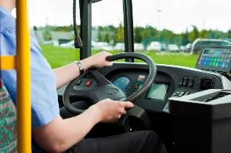
Six in ten riders never use the regular fixed-route bus service which is consistent with last year’s results
Residents of Kamloops (65%) and Vernon (69%) are more likely to say they do not use the regular fixed-route bus service.
Base 2022: n=1,203. Base 2021: Total, n=581. Base 2020: n=453.
Q3. In the past six months, how often have you used the regular fixed-route bus service in your area?

Slide 21
handyDART use is much higher than regular fixed-route bus service use
Base 2022: Total, n=1,203.
Q1. In the past six months, how often have you used the handyDART service in your area?
Q3. In the past six months, how often have you used the regular fixed-route bus service in your area?

Slide 22
Medical appointments are the main trip purpose for HandyDART, while the regular bus is more typically used for running errands
Base 2022: Total, HandyDART users n=1,203, Regular bus service users n=460.
Q2. Which of the following trip purposes do you use handyDART service for? (Multiple mentions)
Q4. Which of the following trip purposes do you use the regular fixed-route bus service for? (Multiple mentions)

Slide 23
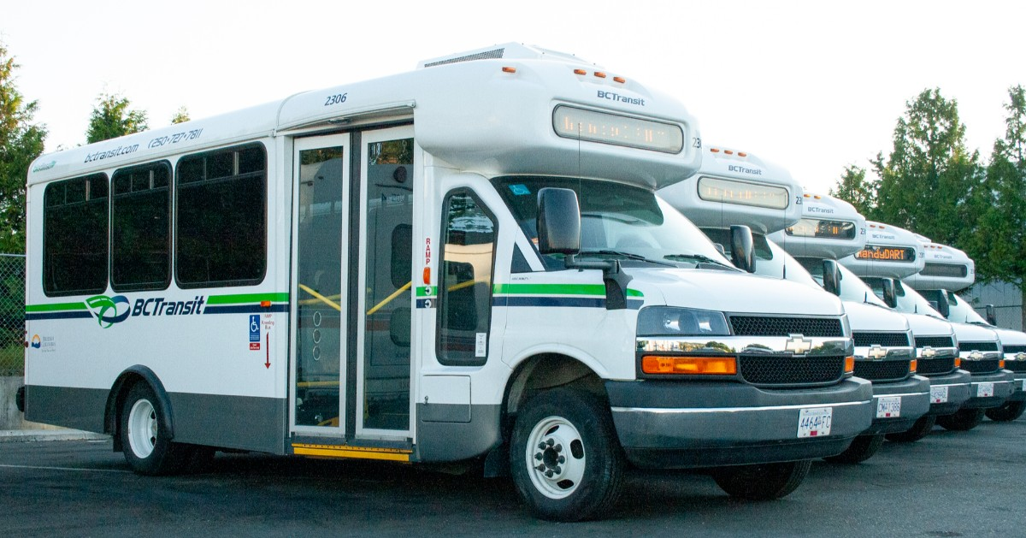
Satisfaction with handyDART service

Slide 24
Overall, nearly eight in ten riders are satisfied with handyDART service in 2022
The 77% satisfied result is directionally lower than in 2021, but not statistically significantly so.
SATISFACTION with the handyDART Service
Heavy and medium-frequency riders (average of 84%) are more likely to say they are satisfied with handyDART service than occasional riders (66%).
Vernon (94%), Victoria and Kamloops (82% each) riders are the most satisfied users compared to other cities.
77% SATISFIED
81% SATISFIED
77% SATISFIED
2022 | 2021 | 2020
*Mentions 3% and greater are shown.
Base 2022: Total, n=1,203. Base 2021: Total, n=581. Base 2020: Total, n=453.
Q6. Overall, how satisfied are you with the handyDART service in your area?

Slide 25
Same as 2021, handyDART riders are most satisfied with driver courtesy and helpfulness
Pick-up window wait time, appointment scheduling process, phone “on hold,” and registration wait times are the service areas with the most opportunity for improvement.
86%
83%
83%
82%
80%
DRIVER COURTESY, HELPFULNESS
VALUE FOR FARE PAID
VEHICLE SAFETY
VEHICLE COMFORT AND CLEANLINESS
PHONE AGENT COURTESY, HELPFULNESS
70%
64%
64%
63%
62%
56%
REGISTRATION PROCESS
HOURS OF OPERATION
REGISTRATION WAIT TIME
PHONE “ON HOLD” WAIT TIME
APPOINTMENT SCHEDULING PROCESS
PICK-UP WINDOW WAIT TIME
The charts show Total Satisfaction (Very Satisfied/Satisfied).
Base 2022: Total, n=1,203.
Q7. How satisfied are you with each of the following elements of handyDART service?

Slide 26
Six in ten feel that handyDART service is about the same as a year ago while two in ten think it’s better
Chilliwack riders (29%) tend more to believe the service is worse than in 2021. Victoria, Prince George and Vernon riders (around one-quarter each) are more likely to think the service has improved compared to last year.
CHANGES in handyDART Service
21% BETTER
26% BETTER
19% BETTER
8% WORSE
3% WORSE
6% WORSE
2022 | 2021 | 2020
Among those who used the handyDART service a year ago(for each wave). Base 2022: n=993. Base 2021: n= 478. Base 2020: n= 387.
Q8. Compared to a year ago, is the handyDART service better, the same, or worse?

Slide 27
Three-quarters of riders are comfortable using transit services during the pandemic
Vernon (93%), Victoria and Kamloops (80% each) riders, as well as heavy riders (89%) and those satisfied with handyDART services (87%), are more apt to feel comfortable taking transit during the pandemic.
COMFORT LEVEL of using transit during the pandemic
76% COMFORTABLE
Base 2022: Total, n=1203.
Q8A. With the current situation in mind, how comfortable do you feel using handyDART and/or regular fixed-route bus service during the pandemic?

Slide 28
Eight in ten are satisfied with the measures that BC Transit has put in place during the pandemic to ensure buses are safe to ride
This is up significantly from 76% in 2021.
SATISTFACTION with Pandemic Safety Measures on Transit
Heavy (92%) riders, as well as subscription trip users (90%), are more likely to be satisfied with BC Transit’s safety measures during the pandemic.
Kamloops (90%), Vernon (89%) and Victoria (85%) riders are more likely to be satisfied with the safety measures compared to other cities.
82% SATISFIED
Base 2022: Total, n=1,203.
Q8B. How satisfied are you with the measures that BC Transit has put in place during the pandemic to ensure that bus transportation is safe to ride (i.e. driver procedures, mandatory masks, disinfection, etc.)?

Slide 29
Key opportunities for service expansion

Slide 30
Three-quarters of riders are not interested in electronic payments or using a website/app to book handyDART trips
Most (81%) would still prefer to book their rides over the phone, especially residents of Vernon (93%), Kamloops (90%), Victoria and Kelowna (81% each).
Interest in using a type of electronic payment
Interest in using a website or app to book a trip
Booking PREFERENCE
28%
TOTAL
INTERESTED
25%
TOTAL
INTERESTED
Base 2022: n=1,203
Q18A: How interested would you be in using a type of electronic payment (e.g. smartphone app, pre-loaded card) to pay for your handyDART trip?
Q18B: How interested would you be in using a website or a smartphone app to book your handyDART trip?
Q18C: Which of the following would you prefer to use to book and manage your handyDART trips?

Slide 31
Same as 2021, introducing HandyDART service on Sundays and holidays are the top two suggestions for service expansion
Coming out of the pandemic, there is some sentiment around using handyDART more for leisure activities.
2022 | TOTAL (n=1,203)
Introduce service on Sundays | 28%
Introduce service on holidays | 20%
Improve availability during existing hours | 18%
Earlier service on weekdays (before 9am) | 18%
Later service on weekdays (after 8pm) | 17%
Later service on Saturdays (after 6pm) | 14%
Extend service to new areas | 8%
Earlier service on Saturdays (before 9am) | 6%
None of the above | 21%
Prefer not to answer | <1%
“I wish there were regional crossovers. I can't use handyDART in Abbotsford or Langley for example.”
“Have more service to & from Sooke - i.e. weekends & more flexibility with times..
“Thornhill, very near Terrace. If anyone else has a trip booked then Thornhill does not get service because it is too far to go.”
“I believe that coming out of this pandemic, it would be a great opportunity for HandyDART to offer “feel good” service, like trips to the Chemainus theatre for their upcoming season.”
“To day trips to farm acres to buy honey, cheese etc. Trips to city events - stat holidays.
“I would love to see trips to other cities like Nanaimo or even coordinating with handyDART in Vancouver to get a trip to the ferry then picked up on the other side.”
“Up island destinations i.e. Shawnigan, Duncan, Mill Bay, Nanaimo, Parksville other smaller towns in between.”
*Mentions 5% and greater are shown.
Base 2022: Total, n=1,203.
Q16. If resources were available to expand handyDART service, what change(s) would you most like handyDART to implement?
Q17. Specifically, what areas would you like handyDART service to cover that it does not today?

Slide 32
Regarding improving availability during existing hours, nearly three in ten would like more buses or a higher frequency of service and two in ten would like a shorter window to book a ride
How to improve handyDART availability during existing hours
2022 | TOTAL (n=217)
More buses/Increased frequency | 28%
Shorter window for booking period | 19%
Shorter wait times | 11%
Scheduling flexibility | 11%
Extend (later) service | 7%
Extend (earlier) service | 4%
“Timing of the scheduled pick up. Shouldn't have to sit waiting in Dr's office for long period waiting for pick up.”
“Although morning pick up is awesome for mom, the return is very long.”
“The ability to book with less than 2 weeks' notice, as I sometimes only find out the date and time of doctor’s appointment a few days before.”
“More trips. It is hard to schedule or have any flexibility when you have to book two weeks away to secure a spot.”
“On a subscription route to ADP 5 days/week. Last month have been on a taxi at least 1-2x/week.”
“Earlier in the AM to be able to get to work and back.”
“I would like the ability to be able to book a trip with less than 2 weeks’ notice. For my safety and others, I would like masks to continue to be mandatory on all handyDART and regular bus services (especially in the autumn, winter and spring months).”
*Mentions 3% and greater are shown.
Base 2022: Those who selected “improve availability during existing hours” in Q16, n=217.
Q18. Specifically, how would you like handyDART service to be more available than it is today?

Slide 33
Suggestions for improvements to handyDART
“I think the handyDART is a great service, drivers are cordial, and usually have a smile on their faces. And careful drivers. New buses to enter by the front of the bus; much better than ramp on the back of the bus.”
“My wife _____ is handicapped and visits a day centre once weekly. handyDART picks her up and brings her home. We are very happy with the service.”
24% Positive comments (pleasant, helpful)
5% Reduce the minimum booking time
“Keep up the good work, and I would be devastated if the handyDART service was discontinued.”
“Very happy with the service received so far. Would be interested in learning about the taxi saver program.”
“Drivers are always polite and helpful, concerned for the riders. Riders are impressed about how they care about people who take handyDART. Lots of compliments to them.
“I would like once a week for booking an appointment instead of 14 days booking an appointment.”
“The booking time should be shorter (e.g. 1-2 days instead of 7 days) especially if it is urgent - medical appointments, treatments. Once I had to use Inter-Facility Transport, which is very expensive.”
“It would be helpful if bookings could be made within 2-3 days of needing service. If payment to taxis could be made without paperwork. Not all drivers are happy with paperwork or with offering service.”
Base 2022: Total, n=1,203.
Q19. Do you have any additional comments or suggestions for improvements to handyDART service?

Slide 34
Suggestions for improvements to handyDART
3% Improve customer service
1% Unwilling / Unable to utilize handyDART during COVID-19
“More buses, more drivers that are nicer, and more polite phone operators. Let’s not forget we are all old or sick or disabled.”
“The communication between drivers & clients when calling to book so we don't get the places to be dropped off & picked up mixed up.”
“When I call to book my trip I usually do not get an answer. They say they will call back, but I usually do not within time. Plus, I would like a shorter time than 2 days.”
“Haven't used handyDART during the past two years as the service has been severely cut due to the pandemic.
“Because of COVID and that I live in an assisted living with restricted time and had a Drs service in house or online I have little need to go out. Also, one friend who sometimes gives rides.”
“Prior to COVID I used handyDART always due to COVID I am only able to use H.D. to doctor & physio.”
Base 2022: Total, n=1,203.
Q19. Do you have any additional comments or suggestions for improvements to handyDART service?

Slide 35
Suggestions for improvements to handyDART
2% Reduced wait times for service
1% More communication/ information
2% Increase service hours
“DS location on my driver. Terrible Sitting Waiting for 45 minutes wondering if they'll show up. Ridiculous waiting 48 hours before you can book an appointment.”
“The ability to book with less than two weeks’ notice. Continued mandatory masks on handyDART and regular bus service (fall, winter and spring).
“Had to sit outside for 50min - 3-times a week.”
“It would be ideal if handyDART could call riders to let them know they were 5-10 min away. Sometimes at the hospital, my appointments run late and I have no way of knowing when my handyDART will come or if they have already come and gone.”
“We have really missed the ability to book and change requests online. While I understand there was a security issue, it has now been months since we have had access to any online booking system. The phone is fine, but definitely more labour intensive and not as convenient.”
“I would like for handyDART to run at nighttime as a lot of events are on at night. as handyDART is done at 430. if they start running at night, I would use it more often.”
“Introduce service on Sundays-my thought was just morning service for Church service hours.”
Base 2022: Total, n=1,203.
Q19. Do you have any additional comments or suggestions for improvements to handyDART service?

Slide 36
Awareness and perceptions of supplemental taxi programs

Slide 37
Almost three-quarters of riders are aware of the Taxi Saver program
Urban riders (79%) are more likely to be aware of the Taxi Saver program than those in rural areas (59%).
Prince George riders (91%) are the most aware of the Taxi Saver program, while Vernon riders are by far the least aware (63%).
AWARENESS of the Taxi Saver Program
AWARENESS of the Taxi Saver Program in 2022
Yes
No
Prefer not to answer
 | REGION |  | CITY
2022 | Urban (n=770) | Rural/ Smaller Urban (n=409) | Victoria (n=354) | Kelowna (n=144) | Abbotsford (n=68) | Kamloops (n=113) | Chilliwack (n=70) | Prince George (n=69) | Vernon (n=54)
Yes | 79% | 59% | 85% | 82% | 85% | 74% | 86% | 91% | 24%
No | 17% | 34% | 12% | 13% | 10% | 25% | 6% | 8% | 63%
Base 2022: n=1,203. Base 2021: Total, n=581. Base 2020: n=453.
Q9. Are you aware of the Taxi Saver program?
Significantly higher at the 95% level.

Slide 38
Six in ten riders who are aware of the Taxi Saver program also use the Taxi Saver program which is consistent with last year’s results
Use is higher among those who book one-time trips (63%). Victoria and Kamloops residents are least likely to use the program (41% and 49%, respectively) compared to other regions.
USAGE of the Taxi Saver Program
USAGE of the Taxi Saver Program in 2022
 | TRIP BOOKING TYPE |  |  | REGION
2022 | Subscription Trip (n=109) | One-Time Trip (n=494) | Both (n=191) | Urban (n=627) | Rural/ Smaller Urban (n=243)
Yes | 58% | 63% | 48% | 59% | 60%
No | 40% | 34% | 51% | 38% | 39%
Yes
No
Prefer not to answer
Among those aware of the Taxi Saver program in Q9 (for each wave). Base 2022: n=870. Base 2021: n=396. Base 2020: n=325.
Q10. Do you use the Taxi Saver program?
Significantly higher at the 95% level.

Slide 39
Riders prefer to have vouchers to use in case they need them in the future or to use the service for short-distance trips.
Prince George Taxi Saver Program users (49%) are more likely to do so for short-distance trips.
REASON FOR USING the Taxi Saver Program
REASON FOR USING the Taxi Saver Program in 2022
 |  | HANDYDART RIDERSHIP FREQUENCY
2022 | TOTAL (n=519) | Heavy Rider (n=97) | Medium Rider (n=257) | Occasional Rider (n=138)
In case I need them in the future | 41% | 46% | 39% | 44%
For several shorter distance trips | 33% | 24% | 31% | 38%
For one or two long distance trips | 12% | 12% | 14% | 10%
Other | 11% | 15% | 12% | 5%
In case I need them in the future
For several shorter distance trips
For one or two long distance trips
Other
Base 2022: Total, n=507.
Q10Aa. If you use the Taxi Saver program, how do you generally use it?
Significantly higher at the 95% level.

Slide 40
More than half of riders who partake in the Taxi Saver program will use it at least once a month--four in ten use the service less than once a month
Victoria, Kelowna and Abbotsford residents (around three-quarters each) are more likely to use the service to go to medical appointments.
FREQUENCY of the Taxi Saver Program Usage
Taxi Saver Trip PURPOSES
Medical appointments
Running errands
Social outings
Medical treatments
Adult day-program
When handyDART is unavailable
Going to work or school
Other
5+ days per week
2-3 days per week
Several times per month
Once a month
Less than once a month
Prefer not to answer
51%
*Mentions 3% and greater are shown.
Base 2022: Those who use the Taxi Saver program in Q10, n=519.
Q10A. How often do you use the Taxi Saver program? Q10B. Which of the following reasons do you use the Taxi Saver program for? (Multiple mentions).

Slide 41
Satisfaction with the taxi company that was dispatched by handyDART is about the same as last year
Half (51%) of riders had a taxi dispatched by handyDART instead of a bus.
Eight in ten are satisfied with the service from the taxi company dispatched by handyDART, with Kelowna users the most satisfied (88%) compared to other cities.
Had a Taxi DISPATCHED instead of a bus
SATISFACTION with the Taxi Company
Yes
No
Don’t recall
Prefer not to answer
79% SATISFIED
76% SATISFIED
84% SATISFIED
2022 | 2021 | 2020
Among those who had a taxi dispatched in Q11 (for each wave). Base 2022: n=614. Base 2021: n= 274. Base 2020: n= 239.
Q11. Have you ever had a taxi dispatched by handyDART when you called to schedule a ride, instead of a bus?
Q12. How satisfied are you with the service you received from the taxi company that was dispatched by handyDART?

Slide 42
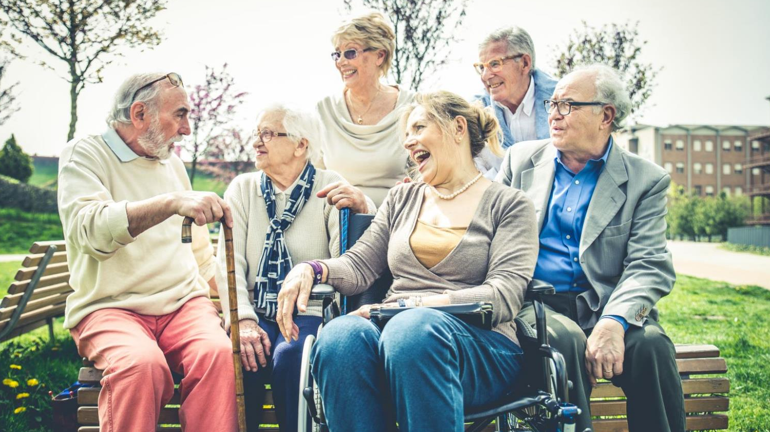
RESPONDENT PROFILE

Slide 43
Demographics
REGION
PASSENGER/A CAREGIVER
CITY
URBAN
66%
PASSENGER
72%
FAMILY
6%
RURAL
34%
CAREGIVER
18%
PARTICIPANT SOURCE
PAPER-BASED
90%
ONLINE
8%
PHONE
2%
Q20. Who completed this survey?
Base 2022: Total, n=1,203.

Slide 44
Appendix

Slide 45
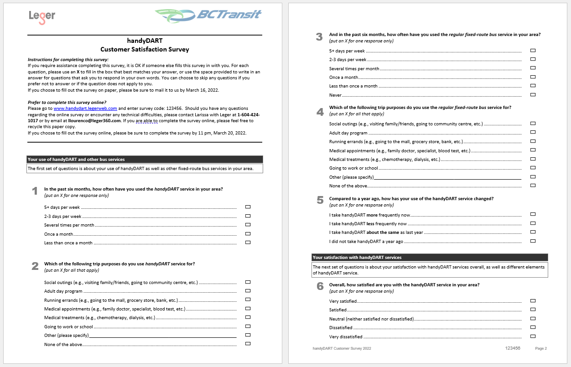
QUESTIONNAIRE

Slide 46
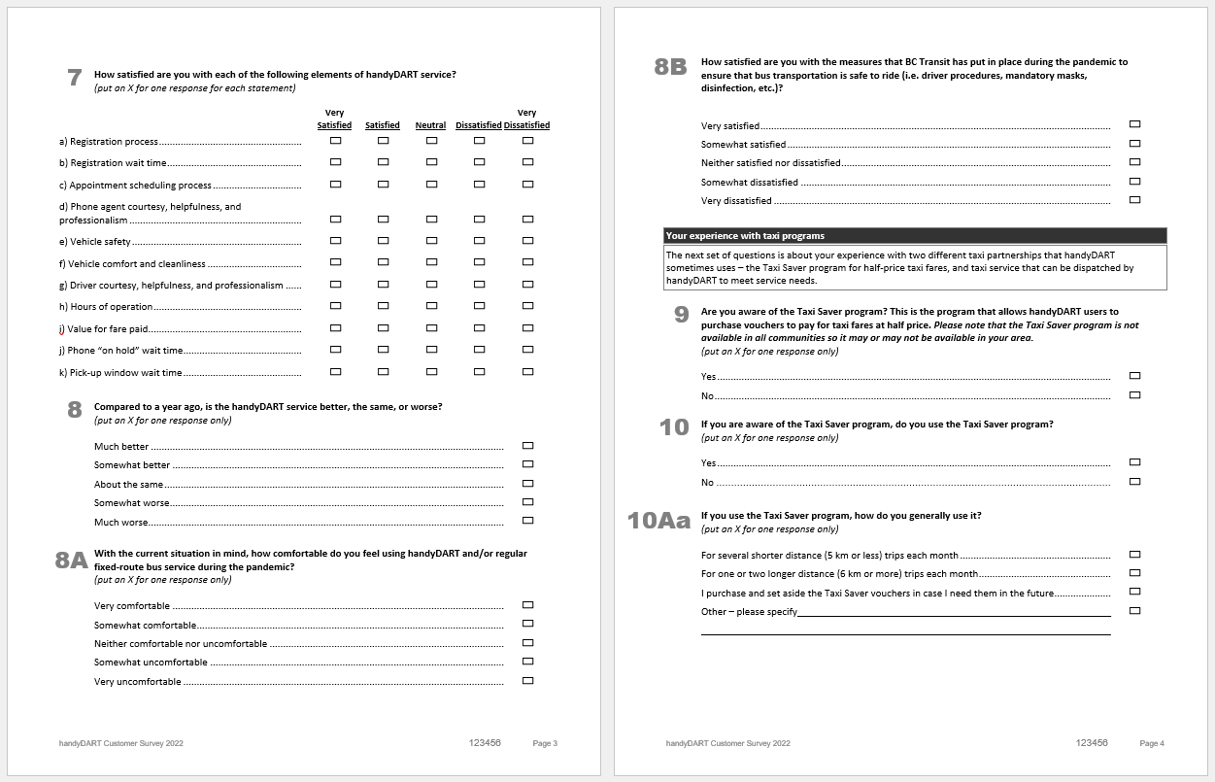
QUESTIONNAIRE

Slide 47
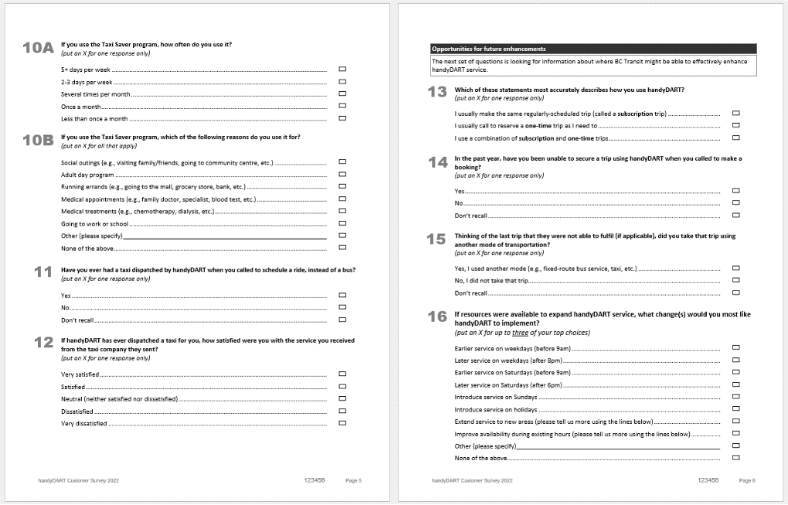
QUESTIONNAIRE

Slide 48
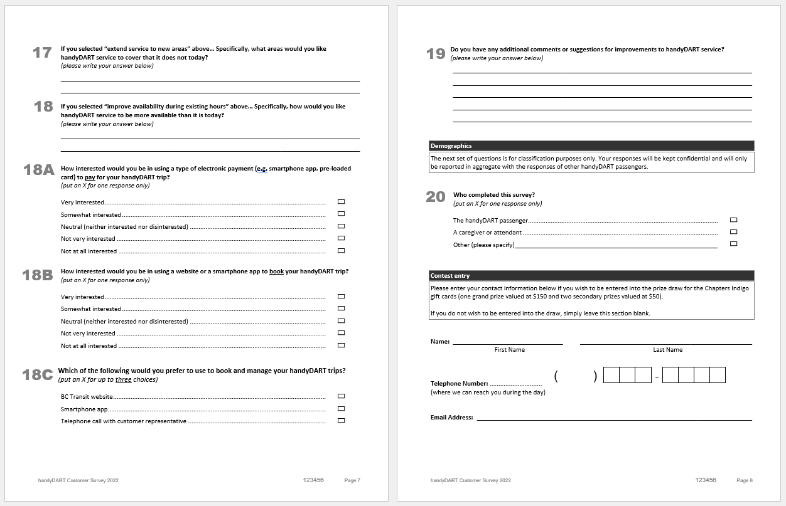
QUESTIONNAIRE

Slide 49
ABOUT LEGER

Slide 52
TIM CHAN
Associate Vice-President
tchan@leger360.com
604-424-1017
LARISSA LOURENCO
Research Analyst
llourenco@leger360.com
604-424-1017

